Slide 1
Recommended System

Slide 2
Definition
A machine learning algorithm known as a recommendation system combines information about users and products to forecast a user's potential interests.
These systems are used in a wide range of applications, such as e-commerce, social media, and entertainment, to provide personalized recommendations to users.

Slide 3
Types of recommendation systems:
`1. Collaborative filtering: -This type of system uses the past behaviour of users to recommend items that similar users have liked.
2. Content-based filtering- This type of system uses the characteristics of items that a user has liked in the past to recommend similar items.
3. Hybrid- To generate suggestions, this kind of system combines content-based filtering and collaborative filtering techniques.
4. Matrix Factorization - Using this method, the user-item matrix is divided into two lower-dimension matrices that are then utilized to generate predictions.
5. Deep Learning- To train the user and item representations that are subsequently utilized to generate recommendations, these models make use of neural networks.

Slide 4
Collaborative Filtering
Collaborative Filtering recommends items based on similarity measures between users and/or items. The basic assumption behind the algorithm is that users with similar interests have common preferences.
Collaborative filtering filters information by using the interactions and data collected by the system from other users. It’s based on the idea that people who agreed in their evaluation of certain items are likely to agree again in the future.
The concept is simple: when we want to find a new movie to watch we’ll often ask our friends for recommendations. Naturally, we have greater trust in the recommendations from friends who share tastes similar to our own.

Slide 5
Collaborative Filtering
Collaborative filtering is a technique that can filter out items that a user might like on the basis of reactions by similar users.
It works by searching a large group of people and finding a smaller set of users with tastes similar to a particular user. It looks at the items they like and combines them to create a ranked list of suggestions.

Slide 6
Content-Based Recommender System
A Content-Based Recommender works by the data that we take from the user, either explicitly (rating) or implicitly (clicking on a link).
By the data we create a user profile, which is then used to suggest to the user, as the user provides more input or take more actions on the recommendation, the engine becomes more accurate.

Slide 7
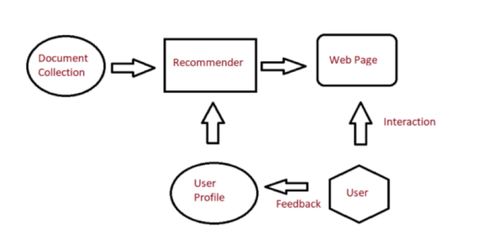

Slide 8
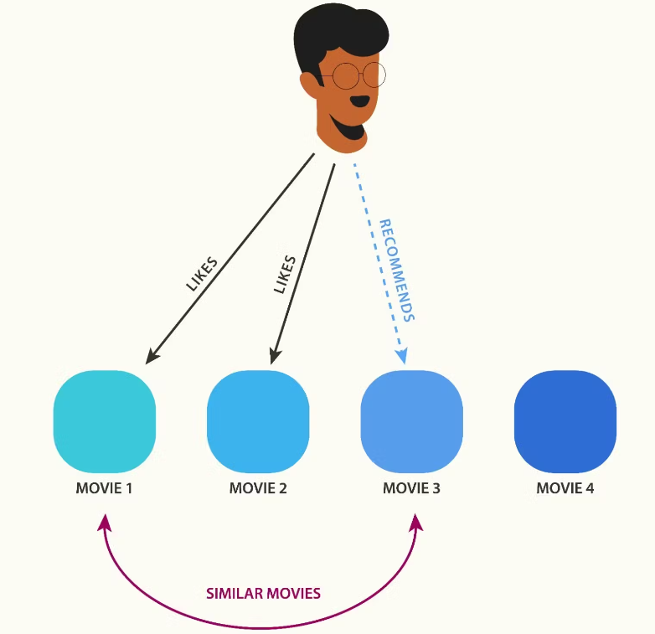

Slide 9
Advantages
It is easily scalable to a large number of customers since the data of other users is not required for recommending something to a particular user.
Since the recommendations are based on the day-to-day activities of the user, all the preferences and parameters of the suggestions are finely tuned to the user’s choice. Therefore, the model can recommend specific niche items that other users might not be interested in.

Slide 10
Disadvantages
Building a content-based recommender engine requires a lot of domain knowledge since the feature selection of the items is mostly hard-coded into the system. Thus, the model is only as good as the knowledge of the one building it.
The model can recommend new items based on the present interest of the user. Hence, discovering and expanding to newer avenues that might interest the user is not possible.

Slide 11
Artificial Neural Network(ANN)
Artificial Neural Networks contain artificial neurons which are called units.
These units are arranged in a series of layers that together constitute the whole Artificial Neural Network in a system.

Slide 12
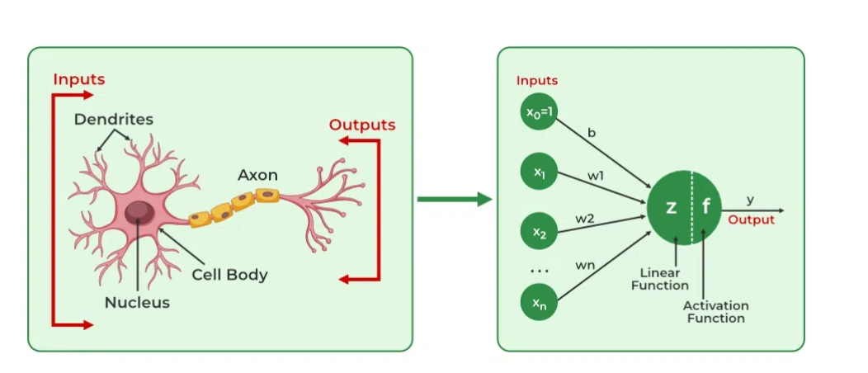

Slide 13
ANN
The structures and operations of human neurons serve as the basis for artificial neural networks.
It is also known as neural networks or neural nets. The input layer of an artificial neural network is the first layer, and it receives input from external sources and releases it to the hidden layer, which is the second layer.
In the hidden layer, each neuron receives input from the previous layer neurons, computes the weighted sum, and sends it to the neurons in the next layer.

Slide 14
Perceptron is Machine Learning algorithm for supervised learning of various binary classification tasks.
Further, Perceptron is also understood as an Artificial Neuron or neural network unit that helps to detect certain input data computations in business intelligence.
Perceptron model is also treated as one of the best and simplest types of Artificial Neural networks. However, it is a supervised learning algorithm of binary classifiers. Hence, we can consider it as a single-layer neural network with four main parameters, i.e., input values, weights and Bias, net sum, and an activation function.

Slide 15
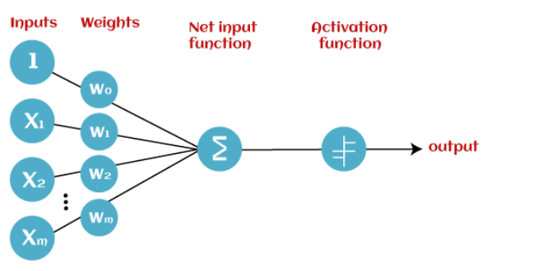

Slide 16
Input Nodes or Input Layer:
This is the primary component of Perceptron which accepts the initial data into the system for further processing. Each input node contains a real numerical value.
Wight and Bias:
Weight parameter represents the strength of the connection between units. This is another most important parameter of Perceptron components. Weight is directly proportional to the strength of the associated input neuron in deciding the output. Further, Bias can be considered as the line of intercept in a linear equation.
Activation Function:
These are the final and important components that help to determine whether the neuron will fire or not. Activation Function can be considered primarily as a step function.

Slide 17
Multi-layer ANN
A fully connected multi-layer neural network is called a Multilayer Perceptron (MLP).
A multi-layer perceptron (MLP) is a type of artificial neural network consisting of multiple layers of neurons.
The neurons in the MLP typically use nonlinear activation functions, allowing the network to learn complex patterns in data.

Slide 18
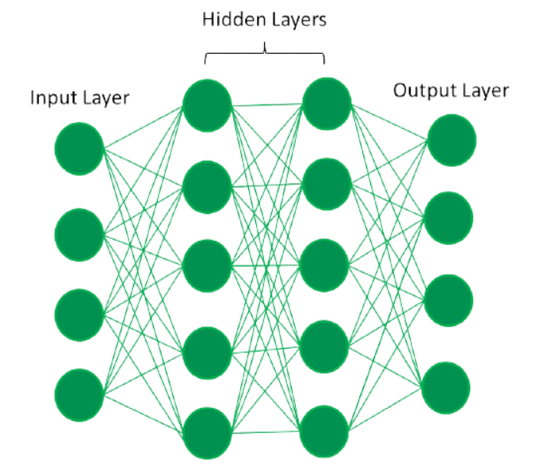

Slide 19
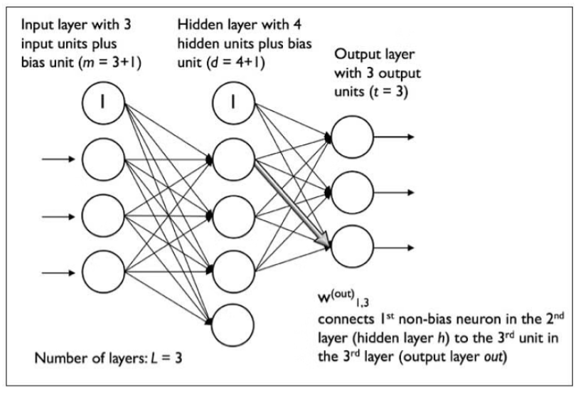

Slide 20
Backpropagation
Backpropagation is the essence of neural net training.
It is the practice of fine-tuning the weights of a neural net based on the error rate (i.e. loss) obtained in the previous epoch (i.e. iteration.) Proper tuning of the weights ensures lower error rates, making the model reliable by increasing its generalization.
In machine learning, backpropagation is an effective algorithm used to train artificial neural networks, especially in feed-forward neural networks.

Slide 21
Backpropagation is an iterative algorithm, that helps to minimize the cost function by determining which weights and biases should be adjusted.
During every epoch, the model learns by adapting the weights and biases to minimize the loss by moving down toward the gradient of the error.
The main features of Backpropagation are the iterative, recursive and efficient method through which it calculates the updated weight to improve the network until it is not able to perform the task for which it is being trained.
Derivatives of the activation function to be known at network design time is required to Backpropagation.

Slide 22
Introduction to Deep learning
Deep learning is the branch of machine learning which is based on artificial neural network architecture.
An artificial neural network or ANN uses layers of interconnected nodes called neurons that work together to process and learn from the input data.
Deep learning is a collection of statistical techniques of machine learning for learning feature hierarchies that are actually based on artificial neural networks.

Slide 23
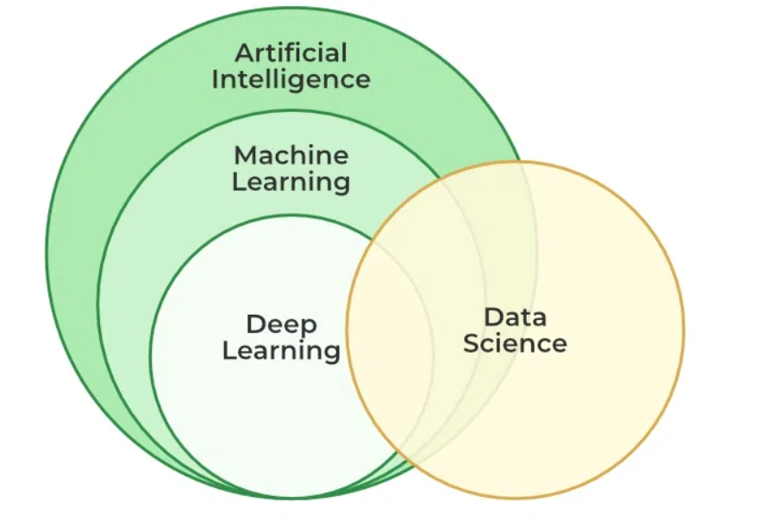

Slide 24
Importance of Deep Learning
Machine learning works only with sets of structured and semi-structured data, while deep learning works with both structured and unstructured data.
Deep learning algorithms can perform complex operations efficiently, while machine learning algorithms cannot.
Machine learning algorithms use labeled sample data to extract patterns, while deep learning accepts large volumes of data as input and analyzes the input data to extract features out of an object.

Slide 25
Application of Deep Learning
Virtual Assistants, Chatbots and robotics
Self Driving Cars
Natural Language Processing
Automatic Image Caption Generation
Automatic Machine Translation

